Slide 1
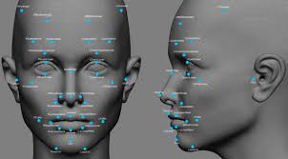
IronHack
FB Face Recognition
Ayub Pathan
16.07.2021

Slide 2
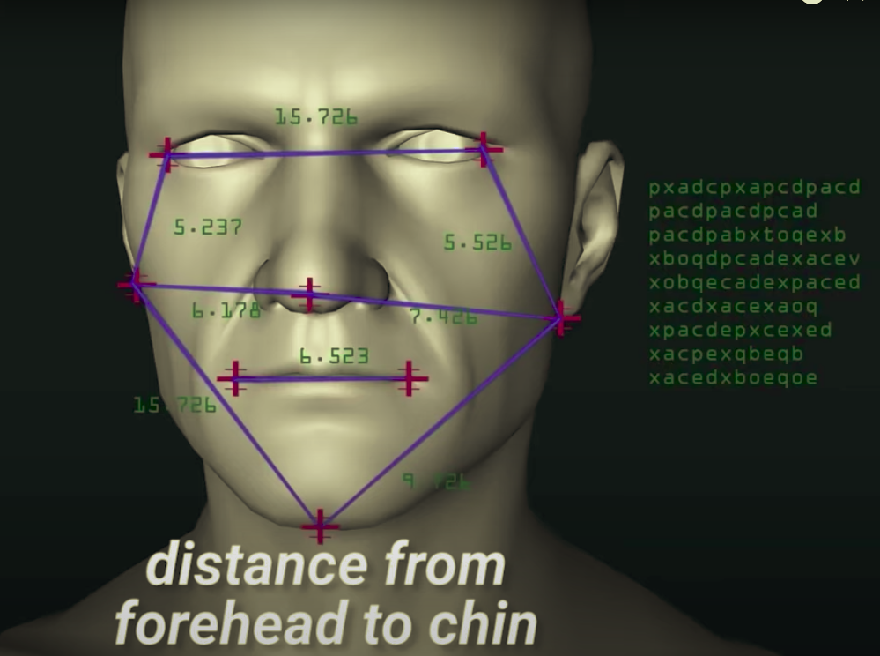
WHAT IS FB RECOGNITION?
Like thumbnails & iris recognition
Special physiological aspects of a person
- Software - photo : alone/in crowd - in real time
- Measurement of nodal points
- Collection of upto 80 different measurements
- ML algorithms - create unique facial features
- Image conversion to grayscale & saved in dataset
- Comparison of facial features with available data

Slide 3
Where it is being used or to be used?
Airports
Railway stations
Banks & financial institutions
Stadiums
Public transport
Government offices
Business establishments

Slide 4
